Slide 1
Excel Advanced Filtering and Custom Criteria
By NIVED SUDHINDRAN

Slide 2
Advance Filtering of Data
If the data you want to filter requires complex criteria
(such as Country = “Mexico" OR Profit = “>20%"), then
you can use the Advanced Filter dialog box
Advanced Filtering can be done in different types, like -
  Multiple Criteria on Single Column
    When multiple filtering operations are performed on a single column
  Multiple Criteria on Multiple Column
    When multiple filtering operations are performed on multiple columns
  Wildcard criteria

Slide 3
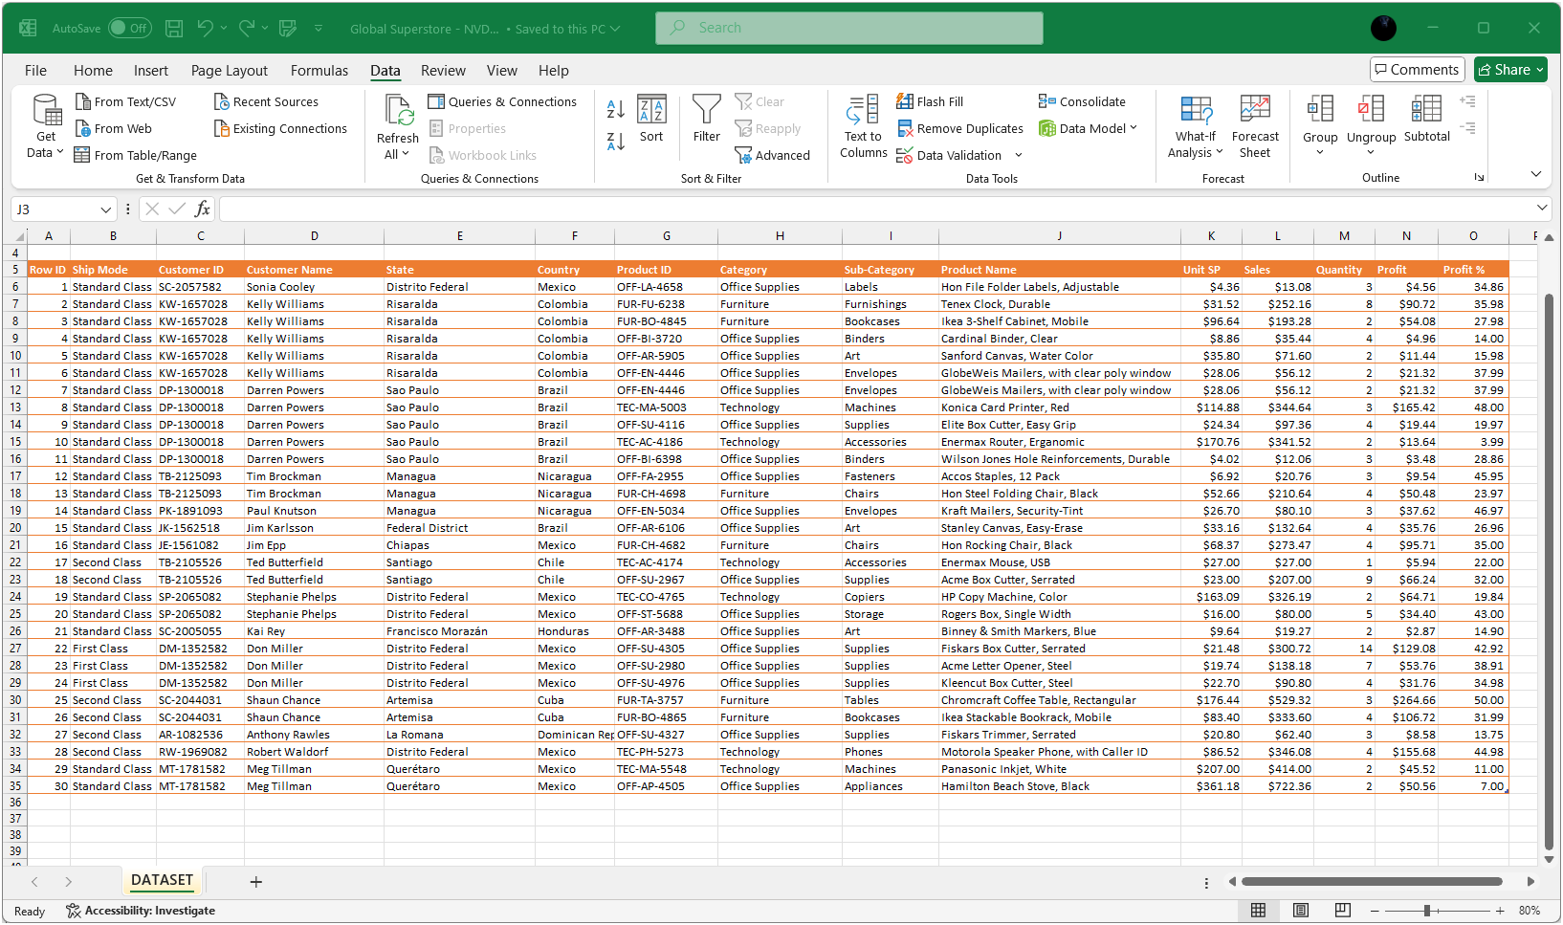
Filtering of Data

Slide 4
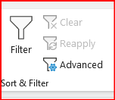
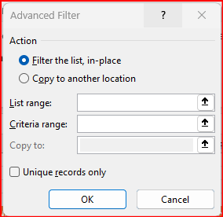
Where to find this Option ?
Under DATA Tab in Excel

Slide 5
THANK YOU

